Slide 1
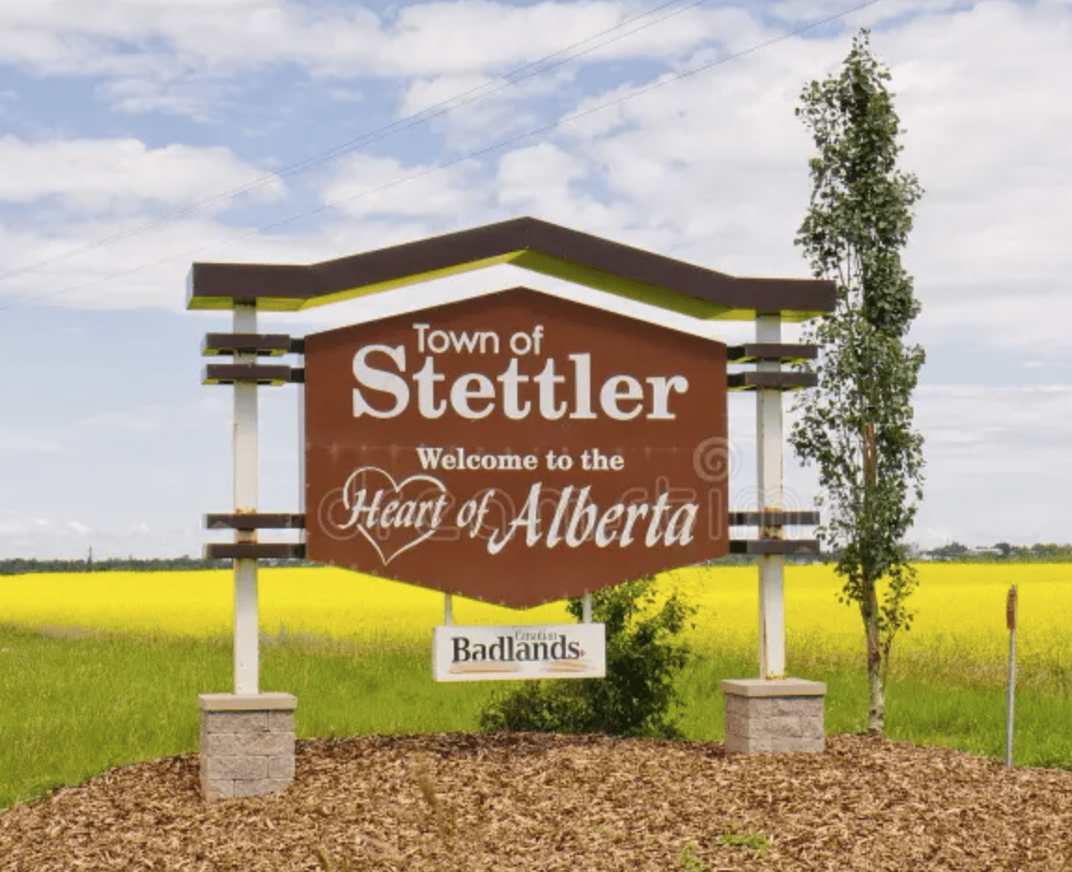
Stettler
We need Doctors, and we need you!

Slide 2
Where is Stettler
79KM east of Red Deer, 84KM to Camrose, 98KM to Drumheller
2 hours to Edmonton Airport and 2 Hours to Calgary Airport
Known as the “Heart” of Alberta ( geographically/anatomically) Stettler people are known to have big hearts and are very generous and kind.
Prime farming country and has oil and gas production and a prominent amount of manufacture of specialty equipment shipped worldwide.
Buffalo Lake is 20 minutes from Stettler and has a large camping and summer population (15,000 people can come to the area on long weekends). It is also an excellent recreation area. Buffalo Lake is the sixth-largest lake in Alberta.

Slide 3
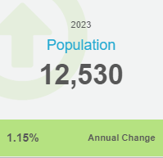
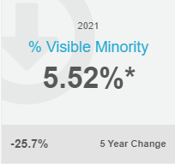
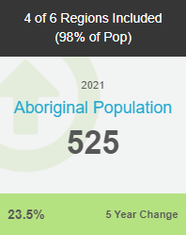
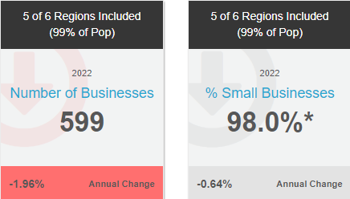
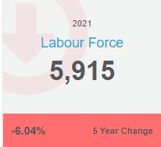
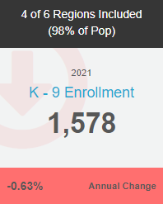
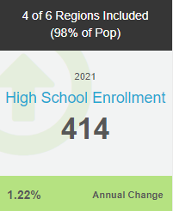
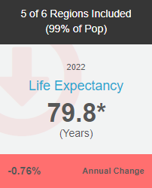
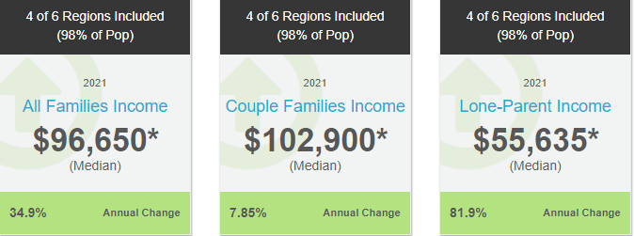
Stettler Town, County, and Village Stats

Slide 4
Drawing Area
Largest center west of the Saskatchewan border
Pulls from 23 communities East of Stettler
Total drawing area is 35,000 people
Largest and most advanced hospital west of the Saskatchewan border (our drawing area) many come for our labor and delivery services.

Slide 5
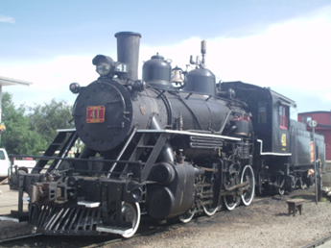
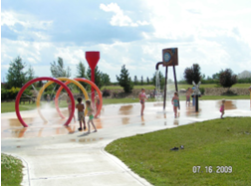
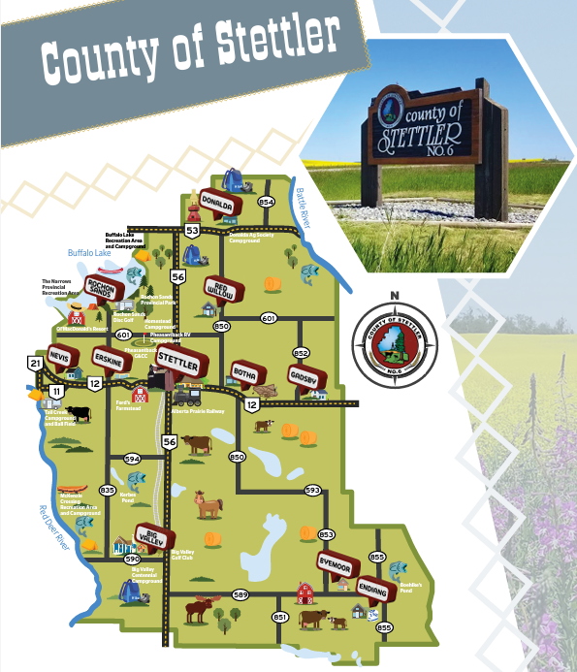
Stettler

Slide 6
Stettler Hospital has a $10MM recently updated Emergency department with eight exam rooms and 2 trauma rooms.
There are 26 acute care beds.
Surgical suite with state-of-the-art anesthesia equipment
2 upgraded labor and delivery suites
Stettler Health Services Foundation is a local foundation that raises community money to support the hospital and, in the last 26 years, has raised 1.4MM dollars purchasing equipment and patient comfort items.

Slide 7
Questions Answered by Doctor Agwaze
An Overview of the Type of Medicine Practiced in the Community
The Structure of the Clinic(s)
The community has all types/varieties of medicine we practice.
Every physician has full control of the type or variety of medicine they choose to practice. You have complete flexibility.
We have the following types of medical practice, you may decide to choose one, some or all of them:
Clinical-based Practice
Emergency Practice
Labour and Delivery
Long Term Care Practice
Supportive/Assisted Living Practice
There are two clinics in Stettler. Each clinic has 10 consulting rooms and 5 offices.
Each clinic has common front staff that work for all the doctors in booking appointments, receiving phone calls, etc. for patients while each doctor has their own MOA (Medical Office Assistant).
Overall, the expense of each clinic is shared equally among the physicians. Your first 2 to 3 months expenses are based on a split (30/70) or the amount that the other physicians are paying – whichever one is the lesser until such a time you start paying the same as the rest of the physicians.

Slide 8
Questions Answered by Doctor Agwaze
Examples of Different Physicians Practice Patterns:
Most physicians do the same in terms of scopey of practice with some individual variations.
Almost all the physicians run a clinic. Some of the physicians do emergency calls some choose not to. Some of the physicians do labour and delivery, while some do anaesthesia. Some of the physicians do long term care.
Again, no hard of strict rules about practice pattern. It all depends on what you want to do.

